Slide 1

Linear Regression
Present: Thanh Tiem
Tháng 12 năm 2019

Slide 2
Nội dung:

Slide 3
Supervised learning
Regression problem
continuous output type
supervised learning
classification problem
Discrete output type

Slide 4
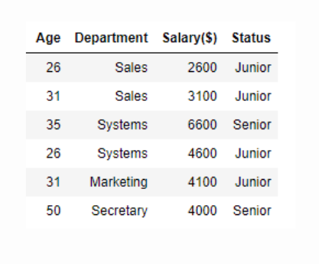
Regression problem && classification problem
Regression: age
Classification: status

Slide 5

How machine learning work?

Slide 6
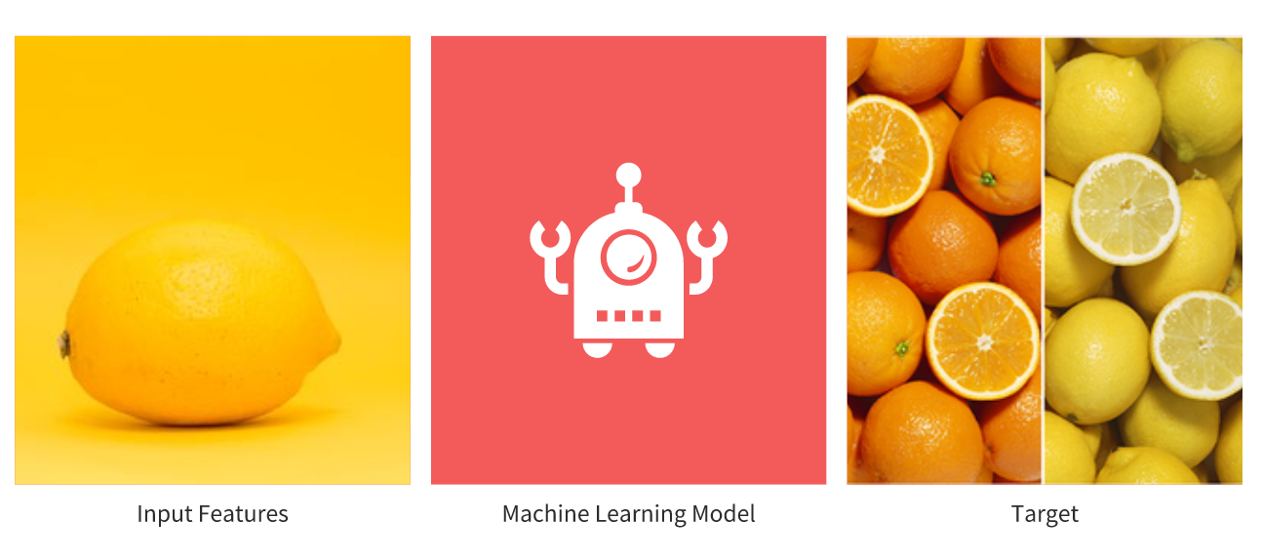
Lemon or orange?

Slide 7
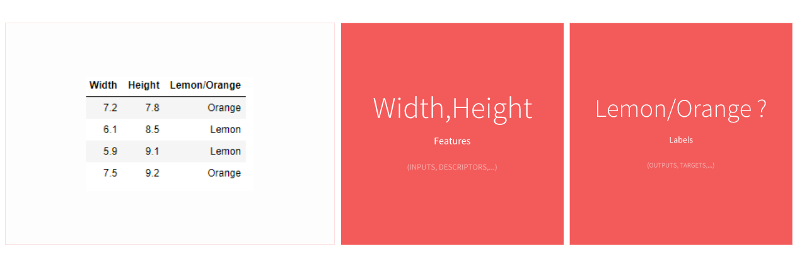
Get data

Slide 8
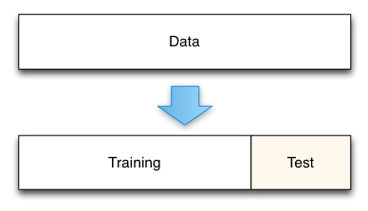
Split data

Slide 9
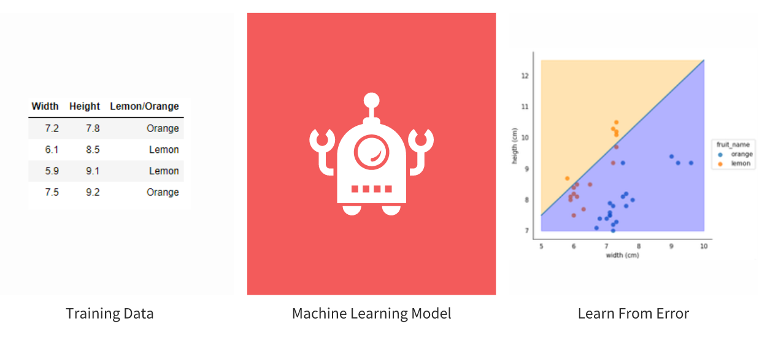
Train model

Slide 10
Linear Regression
Simple linear regression
Multiple linear regression

Slide 11
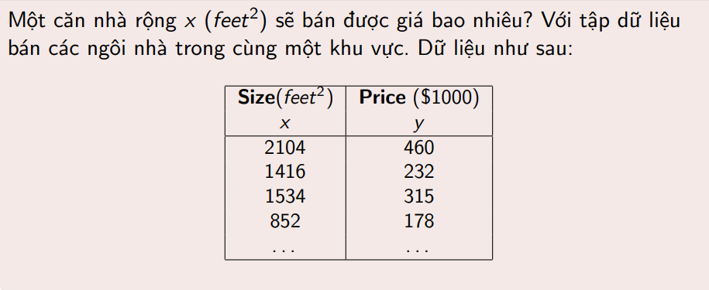
Simple linear regression

Slide 12
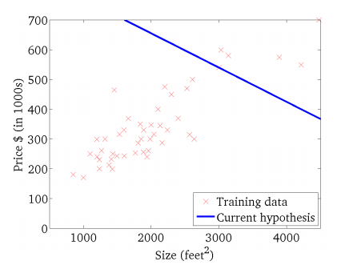
Simple linear regression

Slide 13
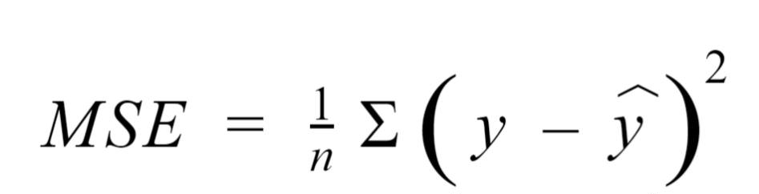
Gradient decent
- Loss function:
- Sử dụng đạo hàm để cập nhật

Slide 14
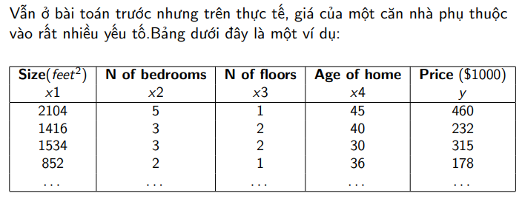
Multiple linear regression

